Slide 1

MUSIC PLAYER WITH GENRE CLASSIFICATION USING CNN
Prepared by:
Subash Limbu (ACE076BCT086)
Sushant Tripathee (ACE076BCT090)
Ujen Lal Shrestha (ACE076BCT094)
Supervised by:
Narayan KC

Slide 2
OVERVIEW
Introduction
Problem Statement
Project Objectives
Literature Review
System Requirements
Methodology
Features
Results ,Analysis and Conclusion

Slide 3
INTRODUCTION
A music genre classifier is a software program that predicts the genre of a piece of music in audio format.
This is important for various applications, such as music recommendation systems, music search engines, and music streaming services.
CNNs are effective in music genre classification due to their ability to learn and extract complex features from audio spectrograms.

Slide 4
The CNN architecture is typically composed of convolutional, pooling, and fully connected layers, enabling the network to learn and represent high-level features.
Researchers are exploring new methods and techniques for feature extraction, data augmentation, and model interpretation to improve performance and analyze results.

Slide 5
PROBLEM STATEMENT
With so much music available, it can be challenging for users to find and discover music that fits their taste and preferences.
Manual genre classification of music tracks is time-consuming and impractical.
Music genre classification using CNNs can help solve this problem by providing a fast and accurate way to classify music tracks into predefined genres.

Slide 6
PROJECT OBJECTIVE
To develop a machine learning model that can accurately classify a given piece of music into one or more predefined genres based on its audio features.

Slide 7
FEATURES
Use of convolutional neural networks (CNNs) to learn and extract features from audio spectrograms of music tracks.
Preprocessing techniques such as normalization, data augmentation, and feature scaling to improve the performance of the model.
Hyperparameter tuning to optimize the performance of the CNN model, such as learning rate, batch size, and regularization techniques.

Slide 8
Analysis and visualization of the learned features to interpret the classification results and gain insights into the relationship between the audio features and genre labels.
Documentation and open-source release of the code and trained model to promote further research in the field of music genre classification using CNN.
Usage of proper activation function which prevents overfitting problem.

Slide 9
SYSTEM REQUIREMENTS
Hardware Requirements
➢Processor: Intel Core i3 or higher
➢RAM: 4 GB DDR or higher
➢Storage: At least 10 GB of free disk space for storing data and model checkpoints
Software Requirements
➢Operating System: Windows, macOS, or Linux
➢Python: Version 3.6 or higher
➢Deep Learning Framework: TensorFlow or PyTorch
➢Audio Processing Libraries: Librosa, Essentia, or similar libraries for audio feature extraction
➢Data Science Libraries: NumPy, pandas, and scikit-learn for data processing and analysis
➢Integrated Development Environment (IDE): Jupyter Notebook or any Python IDE for coding and experimentation

Slide 10
LITERATURE REVIEW
In 2008, Hareesh Bahuleyan worked on Music Genre Classification using Machine Learning techniques, and the model with the Convolutional Neural Network (CNN) approach gave the highest accuracy.
In 2010, Tom LH Li et al. automatic musical pattern feature extraction using a convolutional neural network, where they tried to understand better features that helps in developing a more accurate Music Genre Classification model and proved that CNN is a better tool to read informative features from the varying musical pattern.

Slide 11
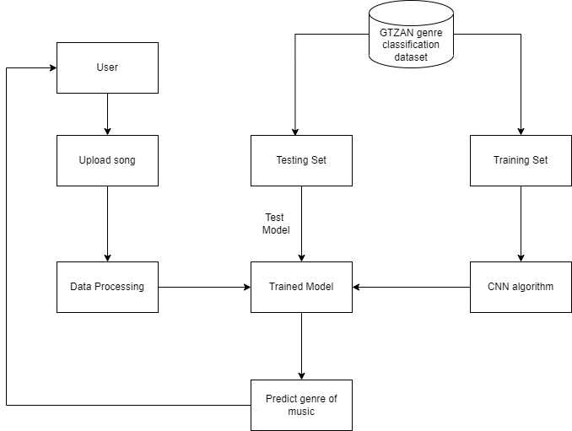
SYSTEM DESIGN
Fig. Block diagram

Slide 12
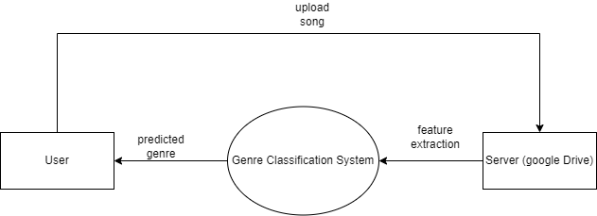
DFD LEVEL 0

Slide 13
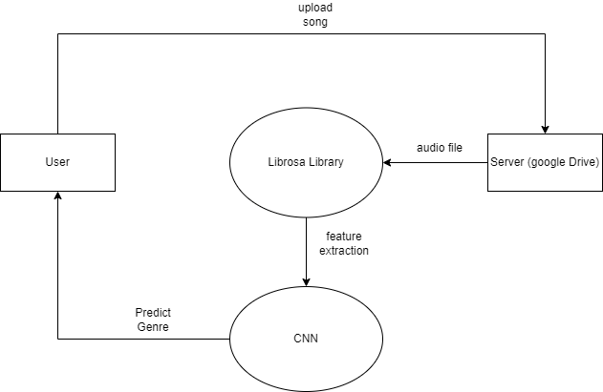
DFD LEVEL 1

Slide 14
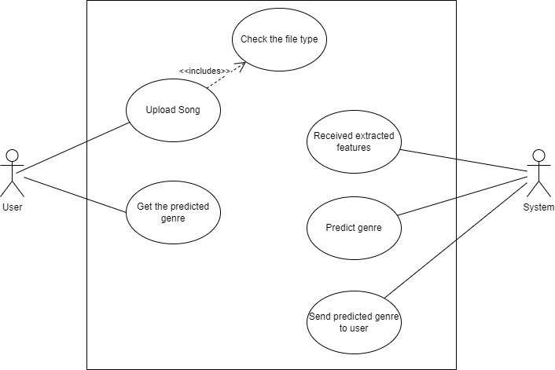
USE CASE DIAGRAM

Slide 15
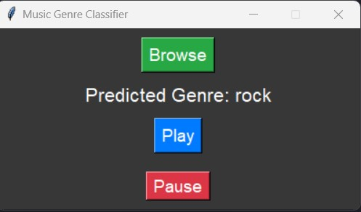
RESULT ANALYSIS AND CONCLUSION
fig: GUI Output

Slide 16
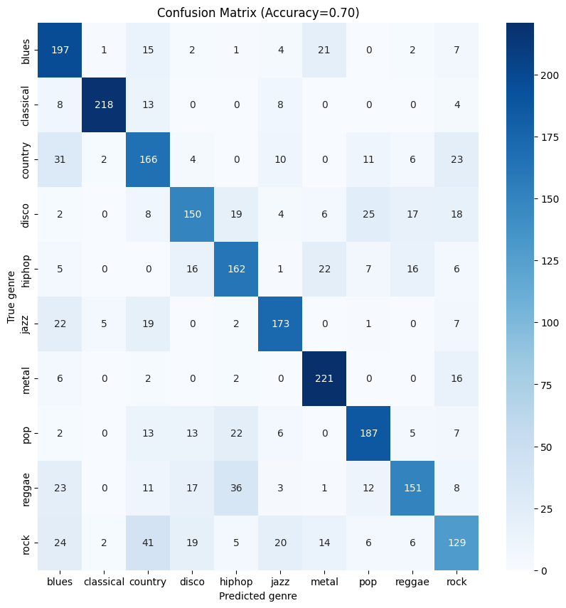
Fig: Confusion Matrix

Slide 17
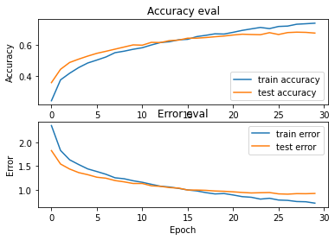
Fig. Train vs Test accuracy and error

Slide 18
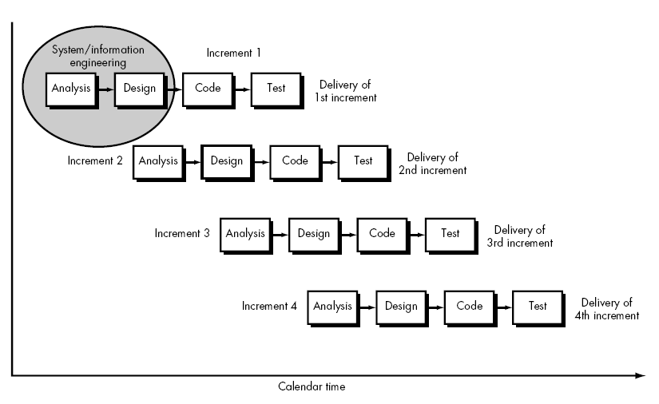
INCREMENTAL MODEL

Slide 19
LIMITATIONS AND FUTURE ENHANCEMENTS
Limitations
Limited access to high-quality audio data
Lack of domain expertise
Limited Time
Limited computing resources

Slide 20
Future Enhancements
Using more sophisticated CNN architectures
Incorporating additional features
Applying transfer learning
Combining multiple models

Slide 21
REFERENCES
S. S. e. al., "MUSIC GENRE CLASSIFICATION USING MACHINE LEARNING," Prasanna Naik, Bangalore, Karnataka, India, 2021. [Accessed 14 12 2022].
J. J. a. F. Pachet, "Music Genre Classification," Journal of Modernization in Engineering Technology and Science, vol. 03, no. 07/May/2021 , p. 957, 2021.
A. Chowdhry, "clairvoyant," an EXL company, 07 05 2021. [Online]. Available: https://www.clairvoyant.ai/blog/music-genre-classification-using-cnn. [Accessed 17 12 2022].
M. Saint-Félix, “t," Towards Data Science, 20 07 2021. [Online]. Available: https://towardsdatascience.com/music-genre-detection-with-deep-learning. [Accessed 16 12 2022].

Slide 22
THANK YOU!

